Slide 1
Singular Value Decomposition (matrix factorization)

Slide 2
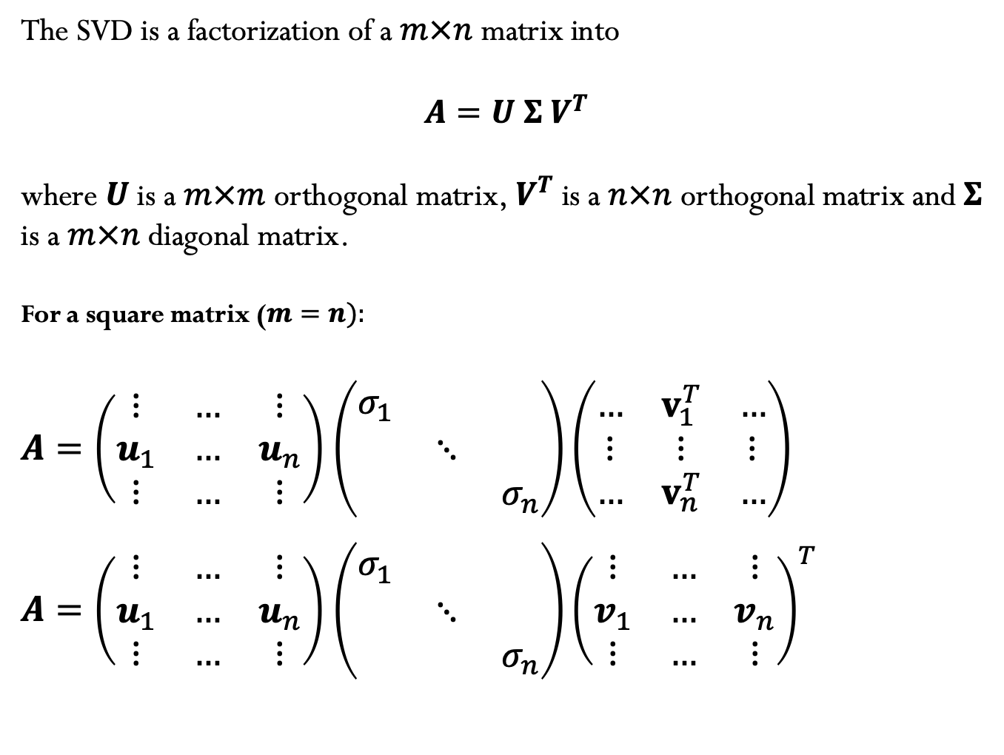
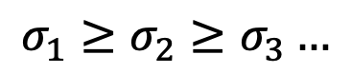
Singular Value Decomposition
The SVD is a factorization of a $m×n$ matrix into
$A=U Σ V^{T}$
where $U$ is a $m×m$ orthogonal matrix,${ V}^{T}$ is a $n×n$ orthogonal matrix and $Σ$ is a $m×n$ diagonal matrix.
For a square matrix ($m=n):$
$A=\left(\begin{matrix}⋮ & … & ⋮ \\ u_{1} & … & u_{n} \\ ⋮ & … & ⋮\end{matrix}\right)$ $\left(\begin{matrix}σ_{1} & & \\ & ⋱ & \\ & & σ_{n}\end{matrix}\right)\left(\begin{matrix}… & v_{1}^{T} & … \\ ⋮ & ⋮ & ⋮ \\ … & v_{n}^{T} & …\end{matrix}\right)$
$A=\left(\begin{matrix}⋮ & … & ⋮ \\ u_{1} & … & u_{n} \\ ⋮ & … & ⋮\end{matrix}\right)$ $\left(\begin{matrix}σ_{1} & & \\ & ⋱ & \\ & & σ_{n}\end{matrix}\right){\left(\begin{matrix}⋮ & … & ⋮ \\ v_{1} & … & v_{n} \\ ⋮ & … & ⋮\end{matrix}\right)}^{T}$
$$σ_{1}≥σ_{2}≥σ_{3}…$$

Slide 3
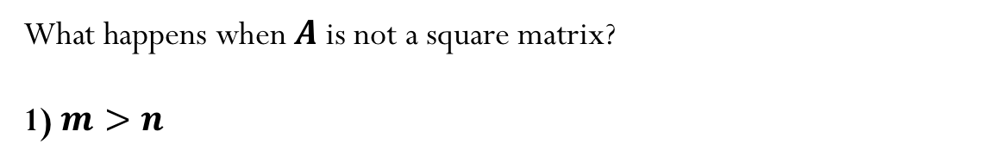
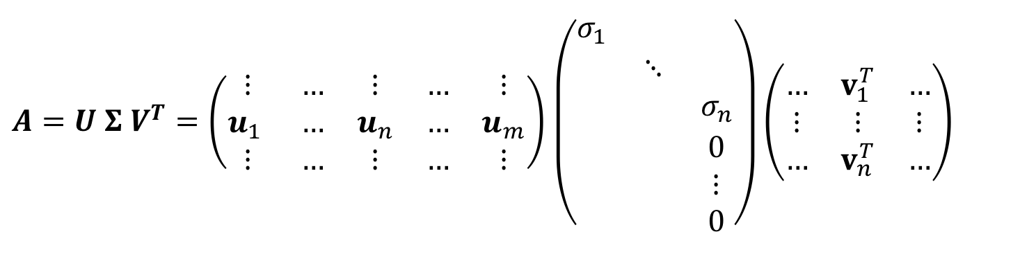
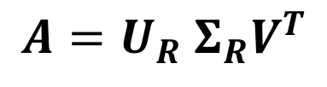
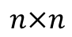
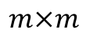
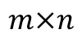
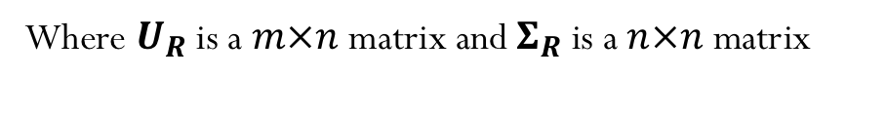
Reduced SVD
What happens when $A$ is not a square matrix?
1) $m>n$
$A=U Σ V^{T}=\left(\begin{matrix}⋮ & … & ⋮ & … & ⋮ \\ u_{1} & … & u_{n} & … & u_{m} \\ ⋮ & … & ⋮ & … & ⋮\end{matrix}\right)$ $\left(\begin{aligned}\begin{matrix}σ_{1} & & \\ & ⋱ & \\ & & σ_{n}\end{matrix} \\ \begin{matrix} & & 0 \\ & & ⋮ \\ & & 0\end{matrix}\end{aligned}\right)\left(\begin{matrix}… & v_{1}^{T} & … \\ ⋮ & ⋮ & ⋮ \\ … & v_{n}^{T} & …\end{matrix}\right)$
$$m×m$$
$$m×n$$
$$n×n$$
We can instead re-write the above as:
$$A=U_{R} Σ_{R}V^{T}$$
Where $U_{R}$ is a $m×n$ matrix and $Σ_{R}$ is a $n×n$ matrix

Slide 4
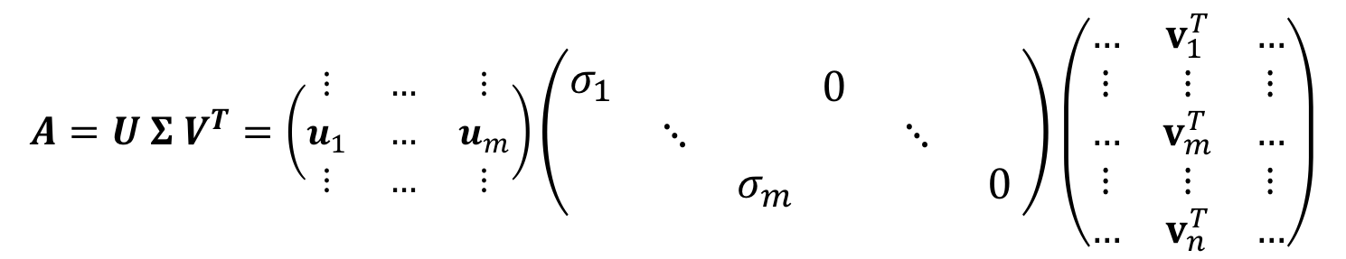
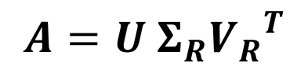
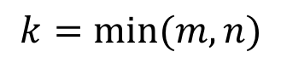
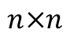
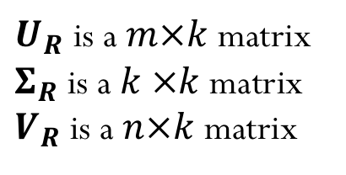
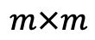
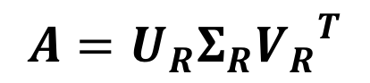
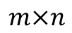
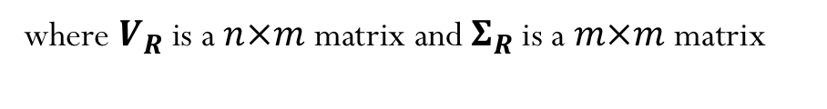
Reduced SVD
2) $n>m$
$$A=U Σ V^{T}=\left(\begin{matrix}⋮ & … & ⋮ \\ u_{1} & … & u_{m} \\ ⋮ & … & ⋮\end{matrix}\right)\left(\begin{aligned}\begin{matrix}σ_{1} & & \\ & ⋱ & \\ & & σ_{m}\end{matrix}\end{aligned} \begin{matrix}0 & & \\ & ⋱ & \\ & & 0\end{matrix}\right)\left(\begin{matrix}… & v_{1}^{T} & … \\ ⋮ & ⋮ & ⋮ \\ … & v_{m}^{T} & … \\ ⋮ & ⋮ & ⋮ \\ … & v_{n}^{T} & …\end{matrix}\right)$$
$$m×m$$
$$m×n$$
$$n×n$$
We can instead re-write the above as:
$$A=U Σ_{R}{V_{R}}^{T}$$
where $V_{R}$ is a $n×m$ matrix and $Σ_{R}$ is a $m×m$ matrix
In general:
$U_{R}$ is a $m×k$ matrix
$Σ_{R}$is a $k ×k$ matrix
$V_{R}$ is a $n×k$ matrix
$$A=U_{R}Σ_{R}{V_{R}}^{T}$$
$$k=min⁡(m,n)$$

Slide 5
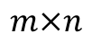
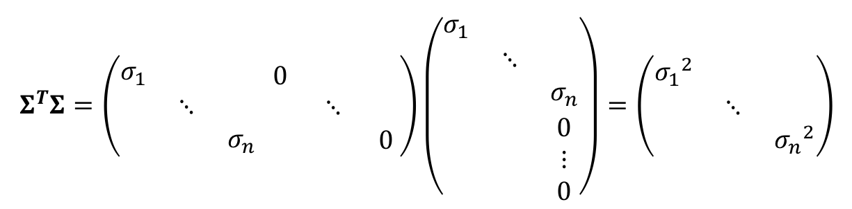
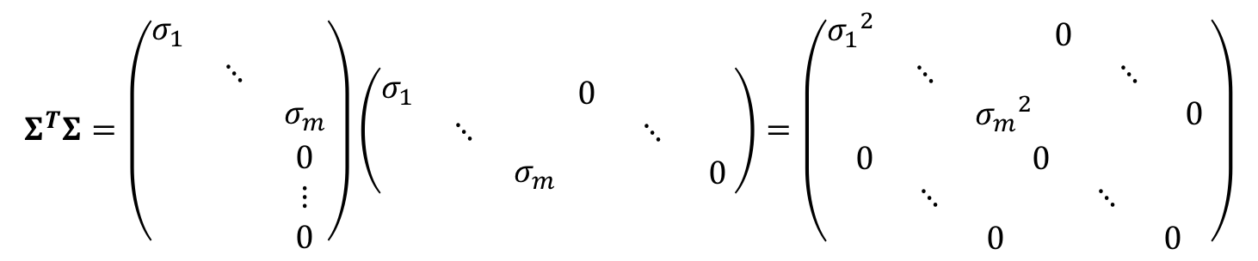
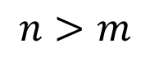
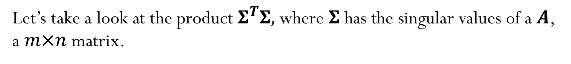
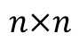
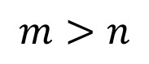
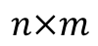
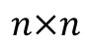
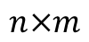
Let’s take a look at the product $Σ^{T}Σ,$where $Σ$ has the singular values of a $A$, a $m×n$ matrix.
$$Σ^{T}Σ=\left(\begin{aligned}\begin{matrix}σ_{1} & & \\ & ⋱ & \\ & & σ_{n}\end{matrix}\end{aligned} \begin{matrix}0 & & \\ & ⋱ & \\ & & 0\end{matrix}\right)\left(\begin{aligned}\begin{matrix}σ_{1} & & \\ & ⋱ & \\ & & σ_{n}\end{matrix} \\ \begin{matrix} & & 0 \\ & & ⋮ \\ & & 0\end{matrix}\end{aligned}\right)=\left(\begin{matrix}{σ_{1}}^{2} & & \\ & ⋱ & \\ & & {σ_{n}}^{2}\end{matrix}\right)$$
$$m>n$$
$$n×m$$
$$n×n$$
$$m×n$$
$$Σ^{T}Σ=\left(\begin{aligned}\begin{matrix}σ_{1} & & \\ & ⋱ & \\ & & σ_{m}\end{matrix} \\ \begin{matrix} & & 0 \\ & & ⋮ \\ & & 0\end{matrix}\end{aligned}\right)\left(\begin{aligned}\begin{matrix}σ_{1} & & \\ & ⋱ & \\ & & σ_{m}\end{matrix}\end{aligned} \begin{matrix}0 & & \\ & ⋱ & \\ & & 0\end{matrix}\right)=\left(\begin{aligned}\begin{matrix}{σ_{1}}^{2} & & \\ & ⋱ & \\ & & {σ_{m}}^{2}\end{matrix} \begin{matrix}0 & & \\ & ⋱ & \\ & & 0\end{matrix} \\ \begin{matrix}0 & & \\ & ⋱ & \\ & & 0\end{matrix} \begin{matrix}0 & & \\ & ⋱ & \\ & & 0\end{matrix}\end{aligned}\right)$$
$$m×n$$
$$n>m$$
$$n×m$$
$$n×n$$

Slide 6
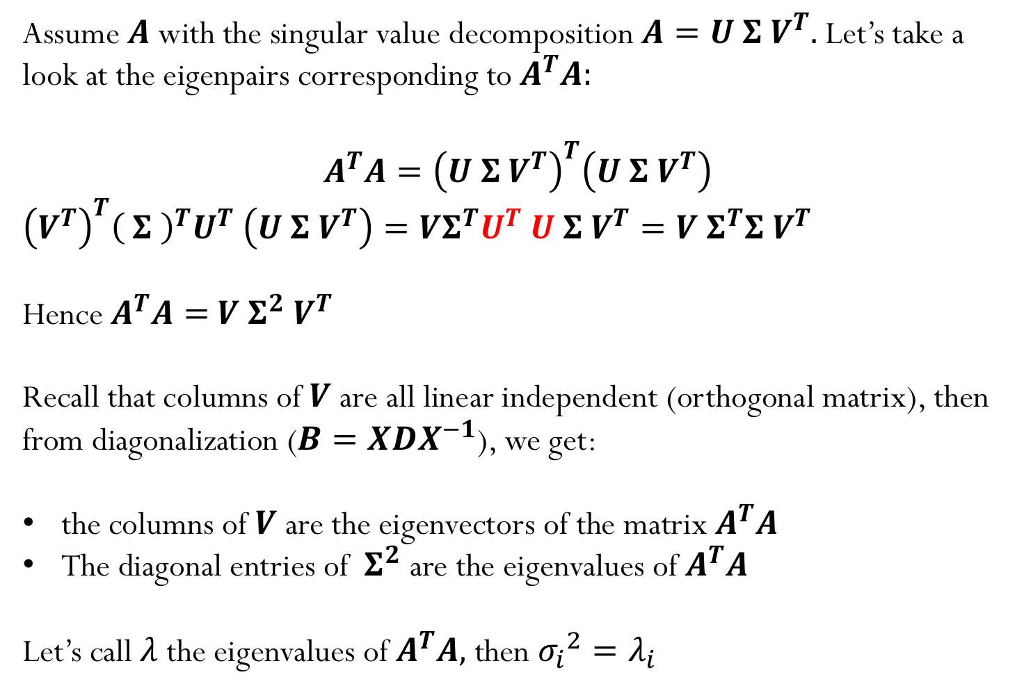
Assume $A$ with the singular value decomposition $A=U Σ V^{T}.$Let’s take a look at the eigenpairs corresponding to $A^{T}A:$
$$A^{T}A={\left(U Σ V^{T}\right)}^{T}\left(U Σ V^{T}\right)$$
${\left(V^{T}\right)}^{T}{\left( Σ \right)}^{T}U^{T}$ $\left(U Σ V^{T}\right)=VΣ^{T}U^{T}$ $U Σ V^{T}=V{ Σ}^{T}Σ V^{T}$
Hence $A^{T}A=$ $V{ Σ}^{2} V^{T}$
Recall that columns of $V$ are all linear independent (orthogonal matrix), then from diagonalization ($B=XDX^{−1}$), we get:
the columns of $V$ are the eigenvectors of the matrix $A^{T}A$
The diagonal entries of ${ Σ}^{2}$ are the eigenvalues of $A^{T}A$
Let’s call $λ$ the eigenvalues of $A^{T}A,$ then ${σ_{i}}^{2}=λ_{i}$

Slide 7
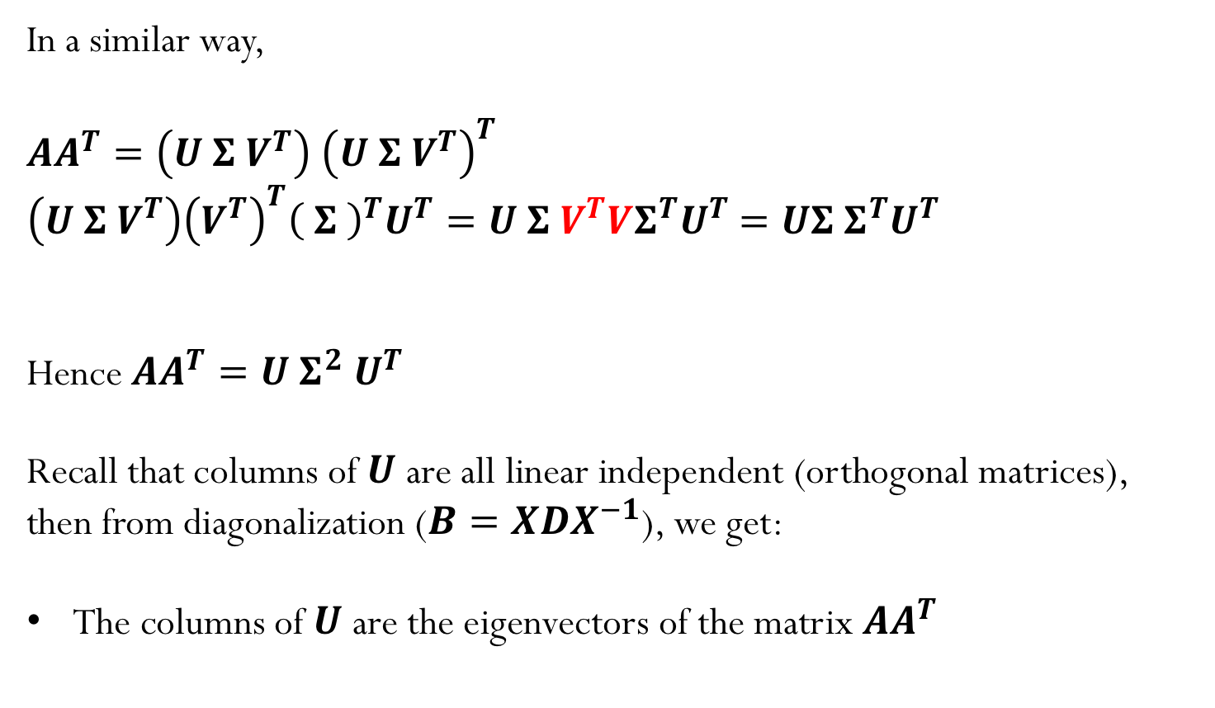
In a similar way,
$AA^{T}=\left(U Σ V^{T}\right)$ ${\left(U Σ V^{T}\right)}^{T}$
$\left(U Σ V^{T}\right){\left(V^{T}\right)}^{T}{\left( Σ \right)}^{T}U^{T}=U Σ V^{T}VΣ^{T}U^{T}$ $=UΣ{ Σ}^{T}U^{T}$
Hence $AA^{T}=U{ Σ}^{2} U^{T}$
Recall that columns of $U$ are all linear independent (orthogonal matrices), then from diagonalization ($B=XDX^{−1}$), we get:
The columns of $U$ are the eigenvectors of the matrix ${AA}^{T}$

Slide 8
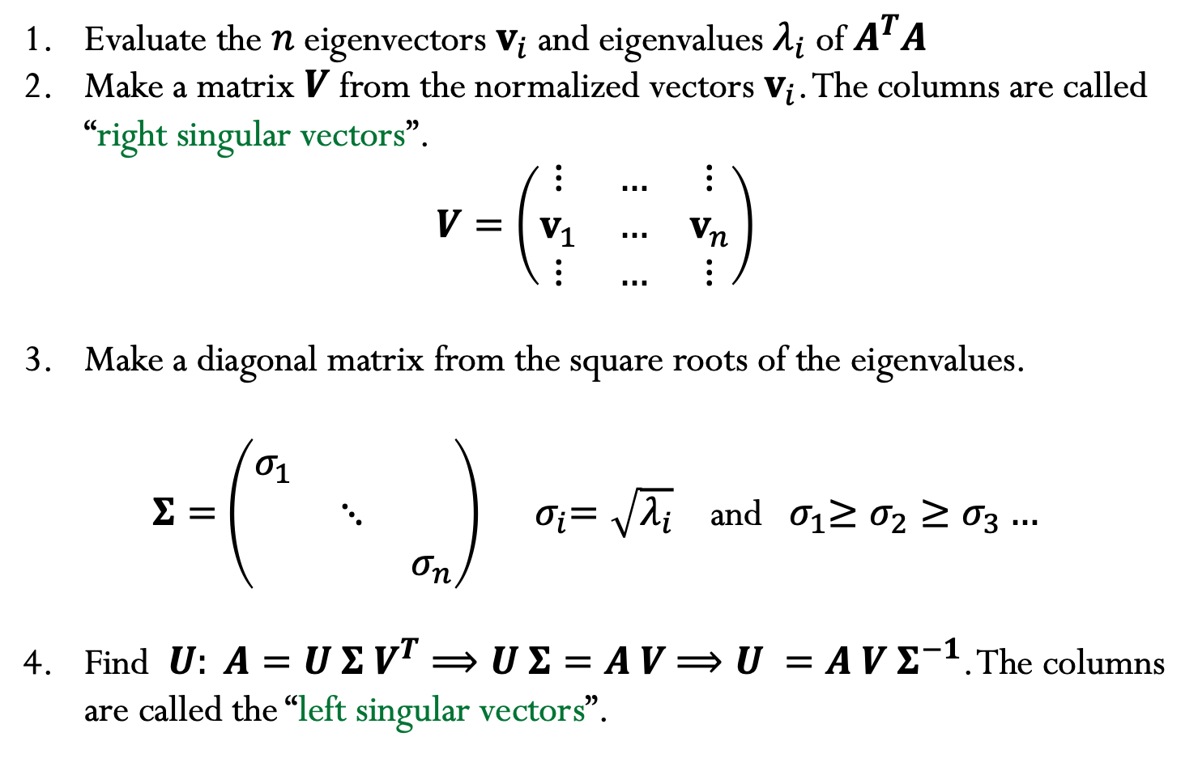
How can we compute an SVD of a matrix A ?
Evaluate the $n$ eigenvectors $v_{i}$and eigenvalues $λ_{i}$of $A^{T}A$
Make a matrix $V$ from the normalized vectors $v_{i}$. The columns are called “right singular vectors”.
$$V=\left(\begin{matrix}⋮ & … & ⋮ \\ v_{1} & … & v_{n} \\ ⋮ & … & ⋮\end{matrix}\right)$$
Make a diagonal matrix from the square roots of the eigenvalues.
$Σ=$ $\left(\begin{matrix}σ_{1} & & \\ & ⋱ & \\ & & σ_{n}\end{matrix}\right)$ ${ σ}_{i}=\sqrt{λ_{i}}$ and ${ σ}_{1}≥σ_{2}≥σ_{3}…$
Find $U: A=U Σ V^{T}⟹U Σ=A V$ $⟹U =A V Σ^{−1}$. The columns are called the “left singular vectors”.

Slide 9
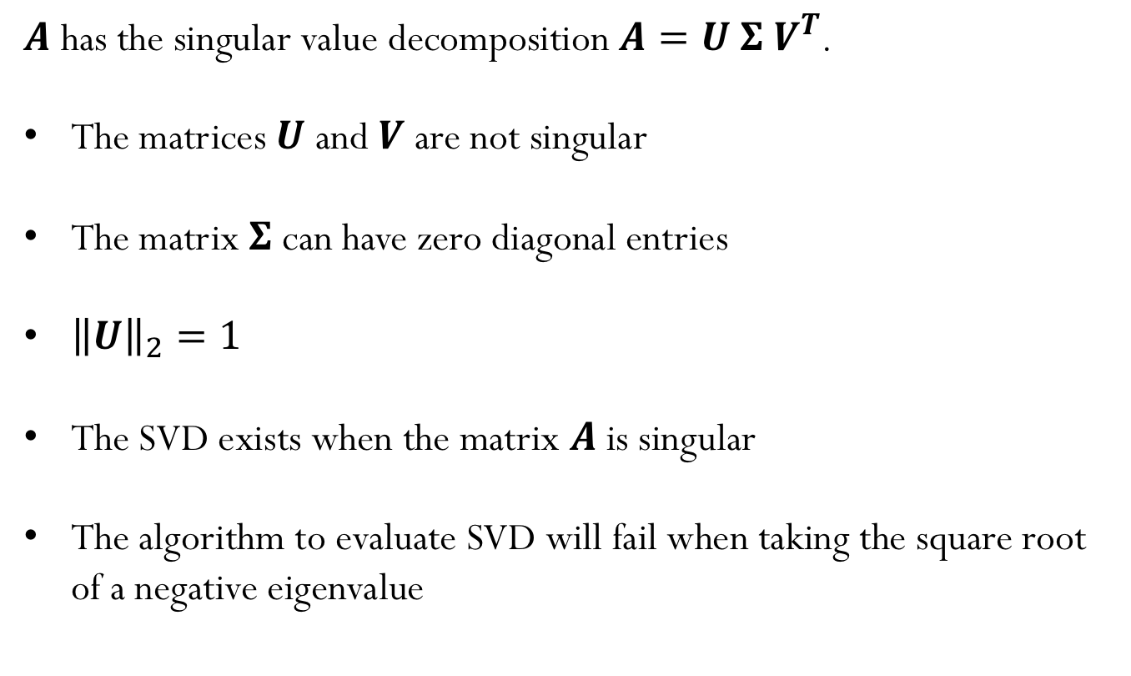
True or False?
$A$ has the singular value decomposition $A=U Σ V^{T}$.
The matrices $U$and $V$ are not singular
The matrix $Σ$ can have zero diagonal entries
${\left\|U\right\|}_{2}=1$
The SVD exists when the matrix $A$ is singular
The algorithm to evaluate SVD will fail when taking the square root of a negative eigenvalue

Slide 10
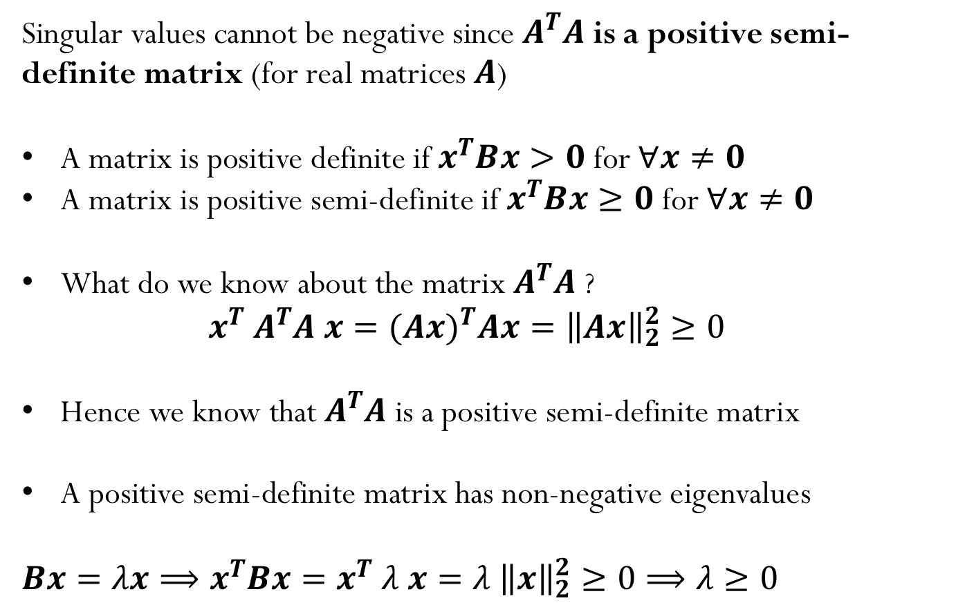
Singular values are always non-negative
Singular values cannot be negative since $A^{T}A$ is a positive semi-definite matrix (for real matrices $A$)
A matrix is positive definite if $x^{T}Bx>0$ for $∀x≠0$
A matrix is positive semi-definite if $x^{T}Bx≥0$ for $∀x≠0$
What do we know about the matrix $A^{T}A$ ?
$$x^{T} A^{T}A x={(Ax)}^{T}Ax={\left\|Ax\right\|}_{2}^{2}≥0$$
Hence we know that $A^{T}A$ is a positive semi-definite matrix
A positive semi-definite matrix has non-negative eigenvalues
${Bx=λx⟹x}^{T}Bx=x^{T}$ $λ x=λ$ ${\left\|x\right\|}_{2}^{2}≥0⟹λ≥0$
Notes:
It will be positive definite if full rank

Slide 11
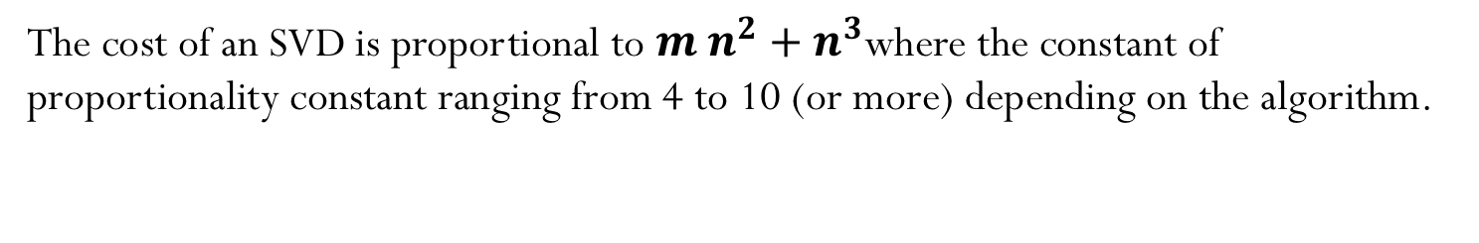
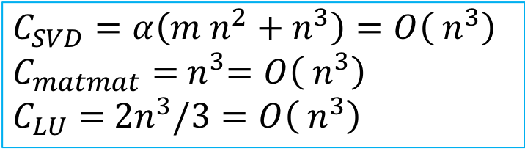
Cost of SVD
The cost of an SVD is proportional to $m{ n}^{2}+{ n}^{3}$where the constant of proportionality constant ranging from 4 to 10 (or more) depending on the algorithm.
$$C_{SVD}=α\left(m{ n}^{2}+{ n}^{3}\right)=O\left({ n}^{3}\right)$$
$$C_{matmat}={ n}^{3}=O\left({ n}^{3}\right)$$
$$C_{LU}={ 2n}^{3}/3=O\left({ n}^{3}\right)$$
Notes:
M n^2 + n^3

Slide 12
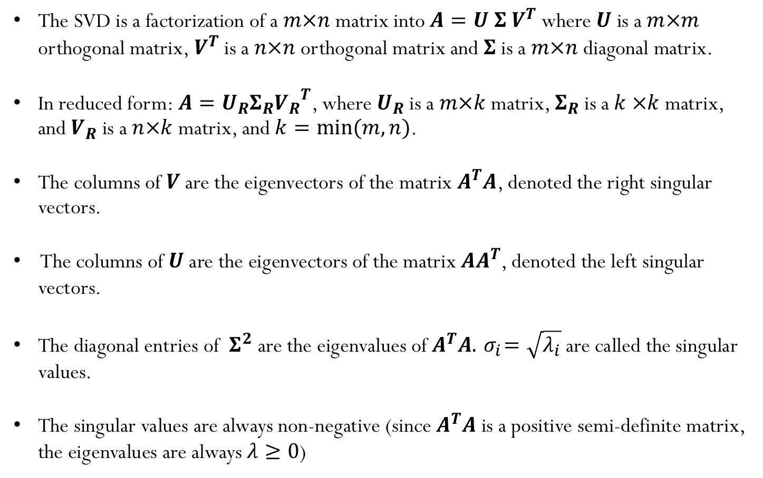
SVD summary:
The SVD is a factorization of a $m×n$ matrix into $A=U Σ V^{T}$ where $U$ is a $m×m$ orthogonal matrix,${ V}^{T}$ is a $n×n$ orthogonal matrix and $Σ$ is a $m×n$ diagonal matrix.
In reduced form:$A=U_{R}Σ_{R}{V_{R}}^{T}$, where $U_{R}$ is a $m×k$matrix, $Σ_{R}$is a $k ×k$ matrix, and $V_{R}$ is a $n×k$ matrix, and $k=min⁡(m,n)$.
The columns of $V$ are the eigenvectors of the matrix $A^{T}A$, denoted the right singular vectors.
The columns of $U$ are the eigenvectors of the matrix $AA^{T}$, denoted the left singular vectors.
The diagonal entries of ${ Σ}^{2}$ are the eigenvalues of $A^{T}A.{ σ}_{i}=\sqrt{λ_{i}}$are called the singular values.
The singular values are always non-negative (since $A^{T}A$ is a positive semi-definite matrix, the eigenvalues are always $λ≥0$)

Slide 13
Singular Value Decomposition (applications)

Slide 14
1) Determining the rank of a matrix
Suppose$A \text{is} \text{a} m×n \text{rectangular} \text{matrix} \text{where} m>n$:
$$A=\left(\begin{matrix}⋮ & … & ⋮ & … & ⋮ \\ u_{1} & … & u_{n} & … & u_{m} \\ ⋮ & … & ⋮ & … & ⋮\end{matrix}\right) \left(\begin{aligned}\begin{matrix}σ_{1} & & \\ & ⋱ & \\ & & σ_{n}\end{matrix} \\ \begin{matrix} & & 0 \\ & & ⋮ \\ & & 0\end{matrix}\end{aligned}\right)\left(\begin{matrix}… & v_{1}^{T} & … \\ ⋮ & ⋮ & ⋮ \\ … & v_{n}^{T} & …\end{matrix}\right)$$
$A=\left(\begin{matrix}⋮ & … & ⋮ \\ u_{1} & … & u_{n} \\ ⋮ & … & ⋮\end{matrix}\right)$ $\left(\begin{matrix}… & σ_{1}{ v}_{1}^{T} & … \\ ⋮ & ⋮ & ⋮ \\ … & σ_{n} v_{n}^{T} & …\end{matrix}\right)=σ_{1}{u_{1}v}_{1}^{T}+σ_{2}{u_{2}v}_{2}^{T}+…+σ_{n}{u_{n}v}_{n}^{T}$
$$A=\sum_{i=1}^{n}{σ_{i}{u_{i}v}_{i}^{T}}$$
${A_{1}=σ}_{1}{u_{1}v}_{1}^{T}$ what is $rank\left(A_{1}\right)= ?$
A) 1
B) n
C) depends on the matrix
D) NOTA
In general, $rank\left(A_{k}\right)=k$

Slide 15
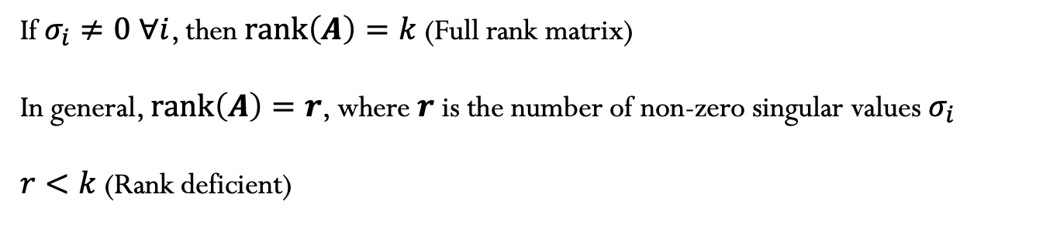
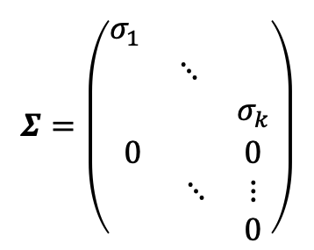
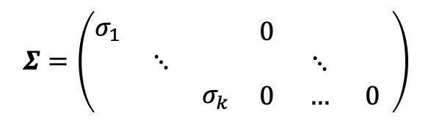
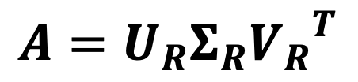
Rank of a matrix
For general rectangular matrix$A$ with dimensions $m×n$, the reduced SVD is:
$$A=U_{R}Σ_{R}{V_{R}}^{T}$$
$$k =min⁡(m,n)$$
$$A=\sum_{i=1}^{k}{σ_{i}{u_{i}v}_{i}^{T}}$$
$$m×n$$
$$m×k$$
$$k ×n$$
$$k×k$$
$$Σ=\left(\begin{aligned}\begin{matrix}σ_{1} & & \\ & ⋱ & \\ & & σ_{k}\end{matrix} \\ \begin{matrix}0 & & 0 \\ & ⋱ & ⋮ \\ & & 0\end{matrix}\end{aligned}\right)$$
$$Σ=\left(\begin{aligned}\begin{matrix}σ_{1} & & \\ & ⋱ & \\ & & σ_{k}\end{matrix} \end{aligned}\begin{aligned}\begin{matrix}0 & & \\ & ⋱ & \\ 0 & … & 0\end{matrix} \end{aligned}\right)$$
If $σ_{i}≠0 ∀i$, then $rank\left(A\right)=k$(Full rank matrix)
In general, $rank\left(A\right)=r$, where $r$ is the number of non-zero singular values $σ_{i}$
$r<k$(Rank deficient)

Slide 16
Rank of a matrix
The rank of A equals the number of non-zero singular values which is the same as the number of non-zero diagonal elements in Σ.
Rounding errors may lead to small but non-zero singular values in a rank deficient matrix, hence the rank of a matrix determined by the number of non-zero singular values is sometimes called “effective rank”.
The right-singular vectors (columns of $V$) corresponding to vanishing singular values span the null space of A.
The left-singular vectors (columns of $U$) corresponding to the non-zero singular values of A span the range of A.

Slide 17
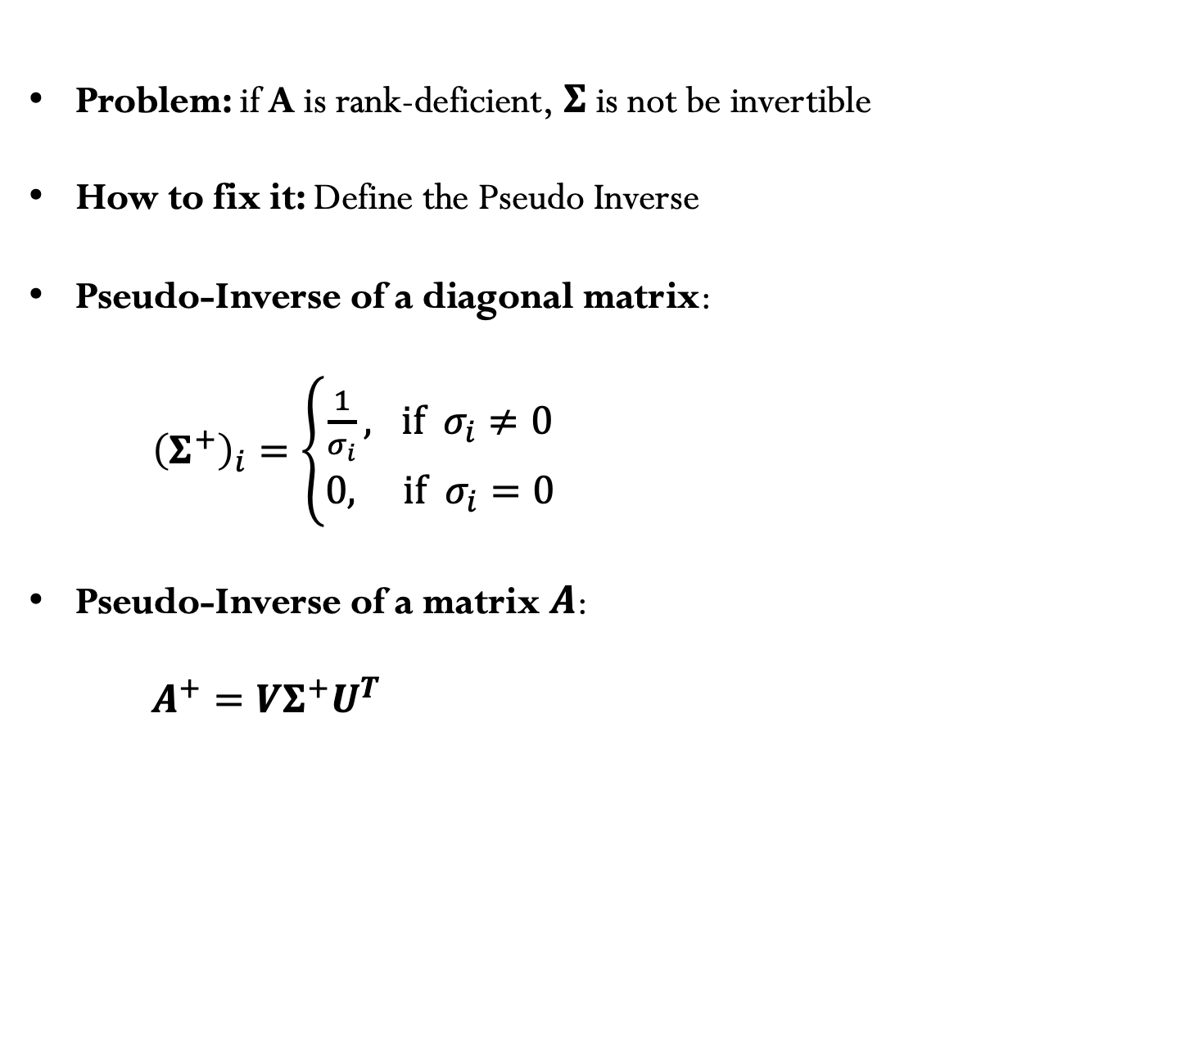
2) Pseudo-inverse
Problem: if A is rank-deficient, $Σ$ is not be invertible
How to fix it: Define the Pseudo Inverse
Pseudo-Inverse of a diagonal matrix:
${\left(Σ^{+}\right)}_{i}=\left\{\begin{matrix}\frac{1}{σ_{i}}, if { σ}_{i}≠0 \\ 0, if { σ}_{i}=0\end{matrix}\right.$
Pseudo-Inverse of a matrix $A$:
$A^{+}=VΣ^{+}U^{T}$

Slide 18

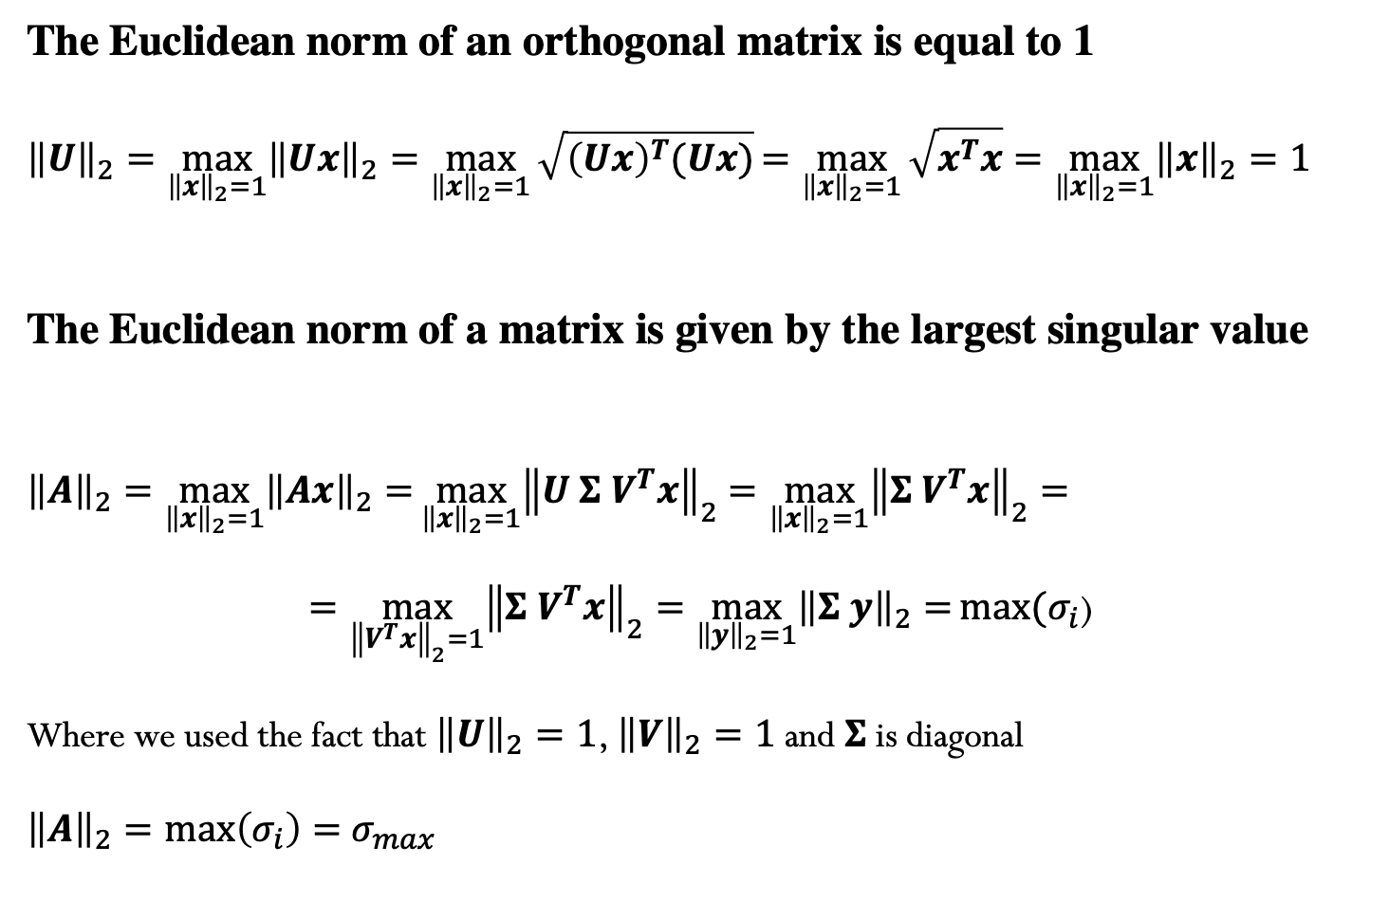
3) Matrix norms
The Euclidean norm of an orthogonal matrix is equal to 1
$${\left\|U\right\|}_{2}=\max_{{\left\|x\right\|}_{2}=1}{{\left\|Ux\right\|}_{2}=\max_{{\left\|x\right\|}_{2}=1}{\sqrt{{\left(Ux\right)}^{T}(Ux)}}}=\max_{{\left\|x\right\|}_{2}=1}{\sqrt{x^{T}x}}=\max_{{\left\|x\right\|}_{2}=1}{{\left\|x\right\|}_{2}=1}$$
The Euclidean norm of a matrix is given by the largest singular value
${\left\|A\right\|}_{2}=\max_{{\left\|x\right\|}_{2}=1}{{\left\|Ax\right\|}_{2}=}\max_{{\left\|x\right\|}_{2}=1}{{\left\|U Σ V^{T}x\right\|}_{2}}$ $=\max_{{\left\|x\right\|}_{2}=1}{{\left\|Σ V^{T}x\right\|}_{2}=}$
$$=\max_{{\left\|V^{T}x\right\|}_{2}=1}{{\left\|Σ V^{T}x\right\|}_{2}=\max_{{\left\|y\right\|}_{2}=1}{{\left\|Σ y\right\|}_{2}=}max⁡(σ_{i}\text{)}}$$
Where we used the fact that ${\left\|U\right\|}_{2}=1$, ${\left\|V\right\|}_{2}=1$ and $Σ$is diagonal
${\left\|A\right\|}_{2}=\max\left(σ_{i}\right)=$ $σ_{max}$
$σ_{max}$ is the largest singular value

Slide 19

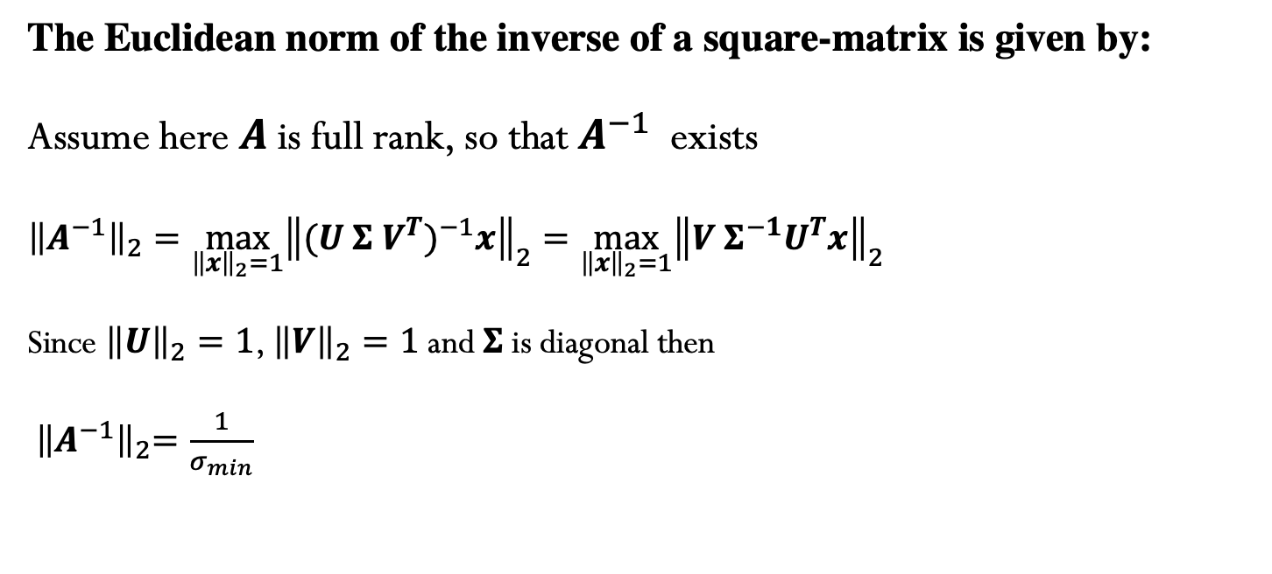
4) Norm for the inverse of a matrix
The Euclidean norm of the inverse of a square-matrix is given by:
Assume here $A$is full rank, so that $A^{−1}$ exists
$${\left\|A^{−1}\right\|}_{2}=\max_{{\left\|x\right\|}_{2}=1}{{\left\|{(U Σ V^{T})}^{−1}x\right\|}_{2}=\max_{{\left\|x\right\|}_{2}=1}{{\left\|V{ Σ}^{−1}U^{T}x\right\|}_{2}}}$$
Since ${\left\|U\right\|}_{2}=1$, ${\left\|V\right\|}_{2}=1$ and $Σ$is diagonal then
${ \left\|A^{−1}\right\|}_{2}=\frac{1}{σ_{min}}$
$σ_{min}$ is the smallest singular value

Slide 20
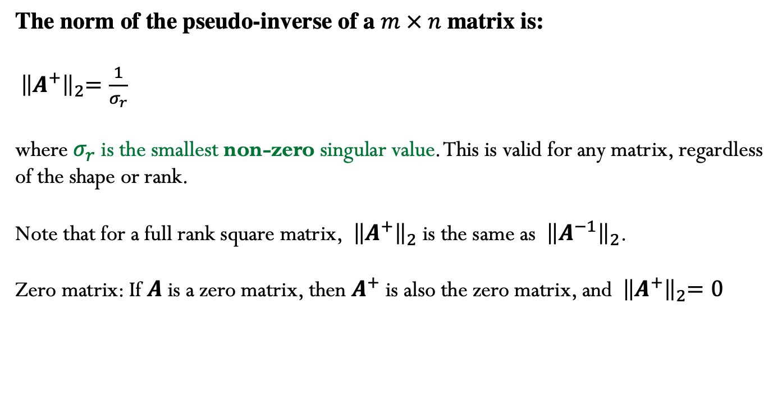
5) Norm of the pseudo-inverse matrix
The norm of the pseudo-inverse of a $m × n$ matrix is:
${ \left\|A^{+}\right\|}_{2}=\frac{1}{σ_{r}}$
where $σ_{r}$ is the smallest non-zero singular value. This is valid for any matrix, regardless of the shape or rank.
Note that for a full rank square matrix, ${ \left\|A^{+}\right\|}_{2}$ is the same as ${ \left\|A^{−1}\right\|}_{2}$.
Zero matrix: If $A$ is a zero matrix, then $A^{+}$ is also the zero matrix, and ${ \left\|A^{+}\right\|}_{2}=0$

Slide 21
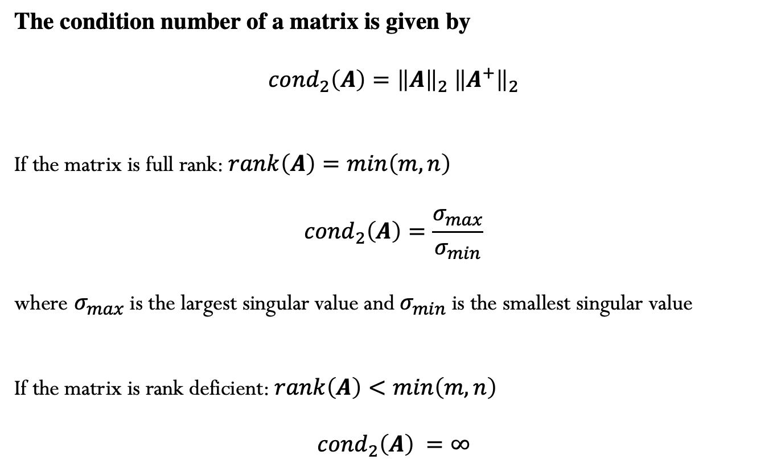
6) Condition number of a matrix
The condition number of a matrix is given by
$${cond}_{2}\left(A\right)={\left\|A\right\|}_{2}{ \left\|A^{+}\right\|}_{2}$$
If the matrix is full rank: $rank\left(A\right)=min\left(m,n\right)$
$${cond}_{2}\left(A\right)=\frac{σ_{max}}{σ_{min}}$$
where $σ_{max}$is the largest singular value and $σ_{min}$is the smallest singular value
If the matrix is rank deficient: $rank\left(A\right)<min\left(m,n\right)$
$${cond}_{2}\left(A\right) =∞$$

Slide 22
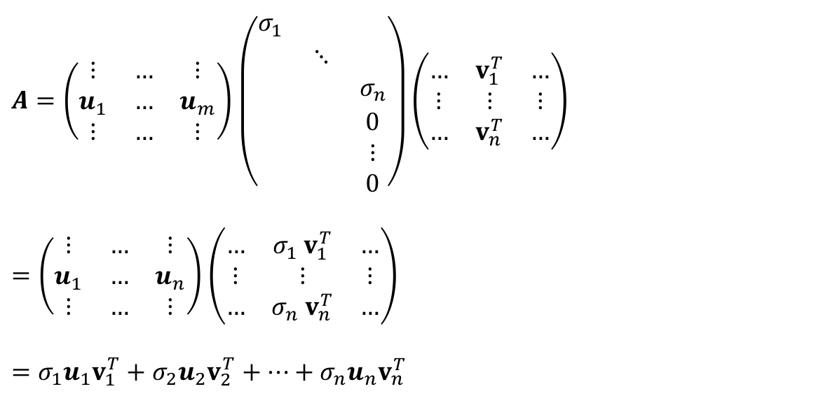
7) Low-Rank Approximation
Another way to write the SVD (assuming for now $m>n$ for simplicity)
$A=\left(\begin{matrix}⋮ & … & ⋮ \\ u_{1} & … & u_{m} \\ ⋮ & … & ⋮\end{matrix}\right)$ $\left(\begin{aligned}\begin{matrix}σ_{1} & & \\ & ⋱ & \\ & & σ_{n}\end{matrix} \\ \begin{matrix} & & 0 \\ & & ⋮ \\ & & 0\end{matrix}\end{aligned}\right)\left(\begin{matrix}… & v_{1}^{T} & … \\ ⋮ & ⋮ & ⋮ \\ … & v_{n}^{T} & …\end{matrix}\right)$
$=\left(\begin{matrix}⋮ & … & ⋮ \\ u_{1} & … & u_{n} \\ ⋮ & … & ⋮\end{matrix}\right)$ $\left(\begin{matrix}… & σ_{1}{ v}_{1}^{T} & … \\ ⋮ & ⋮ & ⋮ \\ … & σ_{n} v_{n}^{T} & …\end{matrix}\right)$
$$=σ_{1}u_{1}v_{1}^{T}+σ_{2}u_{2}v_{2}^{T}+…+σ_{n}u_{n}v_{n}^{T}$$
The SVD writes the matrix A as a sum of outer products (of left and right singular vectors).

Slide 23
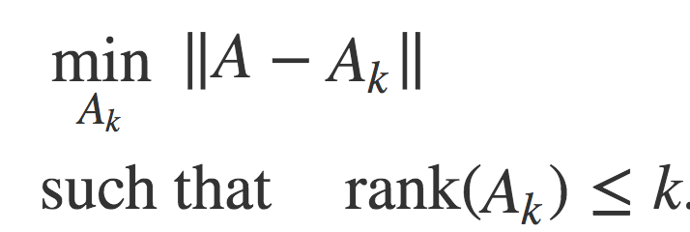
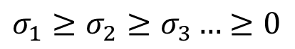
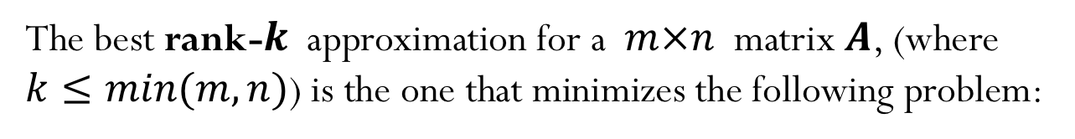
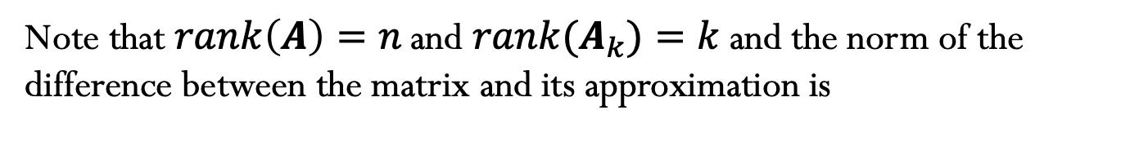
7) Low-Rank Approximation (cont.)
The best rank-$k$ approximation for a $m×n$ matrix $A$, (where $k≤min(m,n)$) is the one that minimizes the following problem:
When using the induced 2-norm, the best rank-$k$ approximation is given by:
$${A_{k}=σ}_{1}u_{1}v_{1}^{T}+σ_{2}u_{2}v_{2}^{T}+…+σ_{k}u_{k}v_{k}^{T}$$
$σ_{1}≥σ_{2}≥σ_{3}…$ $≥0$
Note that $rank\left(A\right)=n \text{and} rank{(A}_{k})=k$ and the norm of the difference between the matrix and its approximation is
$${\left\|A−A_{k}\right\|}_{2}={\left\|σ_{k+1}u_{k+1}v_{k+1}^{T}+σ_{k+2}u_{k+2}v_{k+2}^{T}+…+σ_{n}u_{n}v_{n}^{T}\right\|}_{2}=σ_{k+1}$$

Slide 24








Example: Image compression
$$500$$
$$1417$$
$$500$$
$$500$$
$$1417$$
$$500$$
$$1417$$
$$1417$$

Slide 25


Example: Image compression
$$1417$$
$$500$$
Image using rank-50 approximation

Slide 26

8) Using SVD to solve square system of linear equations
If $A$is a $n×n$ square matrix and we want to solve $A x=b$, we can use
the SVD for $A$ such that
$$U Σ V^{T}x=b$$
$$Σ V^{T}x=U^{T}b$$
Solve: $Σ y=U^{T}b$ (diagonal matrix, easy to solve!)
Evaluate: $x=V y$
Cost of solve: $O\left(n^{2}\right)$
Cost of decomposition $O\left(n^{3}\right)$(recall that SVD and LU have the same cost asymptotic behavior, however the number of operations - constant factor before $n^{3}$- for the SVD is larger than LU)
Notes:
Can use SVD to solve square system of linear equations, but no advantage over LU decomposition

